Slide 1
Can Dumb Clients Make Smart Synchronization Decisions?
ITSF 2018

Slide 2
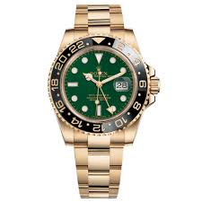
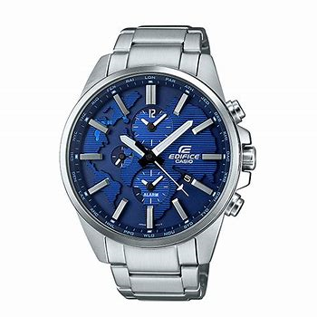
Choices in a Timekeeping Client?
Power: Automatic, Wind Up, Solar
Accuracy: Day-to-Day, Constant Offset
Adjustments: Manual, Radio
Heritage: Europe, Asia
Movement: Jewel, Quartz

Slide 3
Choices in a IEEE-1588v2 Timekeeping Client?
[Power] Best Master Clock Algorithm
[Accuracy] Network Architecture
[Adjustment] PTP Clock Recovery Algorithm
[Heritage] Timing Expertise Legacy
[Movement] Internal Clock Grade

Slide 4
PTP Clock Recovery Algorithm
All Implementations are Proprietary
IEEE-1588 Does Not Define All Behavior
Different Clients Will Lead to Different Architectures
Graphic Placeholder

Slide 5
Best Master Clock Algorithm
Graphic Placeholder
Where is the BEST in BMCA?
Implementations Vary by Equipment
Multiple Clock Domains Create Multiple Problems
Really Only Does What the Master Tells It To Do

Slide 6
Network Architecture
Disparate Networks May Have Different Performances Characteristics Affecting Timekeeping
Clients Have the Ability to Select from Multiple Grandmasters
Today’s Networks are Inherently Multiple Path
Graphic Placeholder

Slide 7
Redundancy
Graphic Placeholder
Single Master to Single Client can be Made Redundant
Hardware Redundant Server
Multiple Path
Multiple Solutions to Redundancy
Physical Redundancy
Physical Diversity
Failover Redundancy

Slide 8
Limitations of ACCURATE Timekeeping on the Client
Graphic Placeholder
Network Performance
Hops Between Client and Master
Path Asymmetry
Local Oscillator Quality
Adaptability to Changing Environment

Slide 9
Recommendations

Slide 10
Thank you!

